Slide 1
Innovation in Education – an engine for change
Ian Curran
Postgraduate Dean
Dean of Educational Excellence
Head of Innovation
10th May 2011

Slide 2
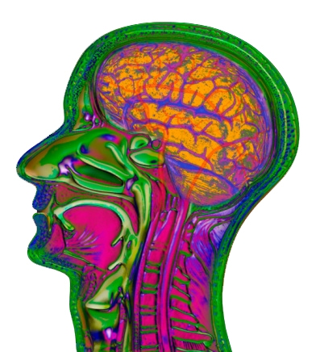
A dispersed regional enabling strategy
Simulation &
Technology-
enhanced
Learning
Initiative

Slide 3
‘Innovation is meaningless without operational excellence’

Slide 4
Overview
Context and Philosophy of STeLI
Highlight challenges
Explore what it means to be professional
Introduce the concept of ‘Aspiring to Excellence’
Explore the challenges of cultivating professionals
The vital ingredients for success…faculty
Highlight opportunities and innovations

Slide 5

Part of the ‘Excellence in Education’ strategy of NHS London
Fully integrated £23 million workforce development initiative
60,000+ multi-disciplinary and inter-professional simulation based activities
2,100 facilitators trained in behavioural debriefing
92 dispersed sites including 24 new centres
£3.5million R+D strategy over 70 educational projects

Slide 6
Education Commissioning Strategy
Specialty
Service
Educational Capacity and capability

Slide 7
The challenges… of aspiring to educational excellence
Education is CORE
Healthcare Business
Clinical Service
Research
Research

Slide 8

The challenges…

Slide 9

Times of plenty….

Slide 10
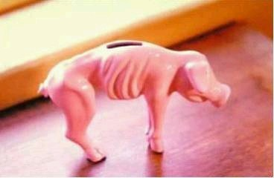
Lean times are coming…

Slide 11
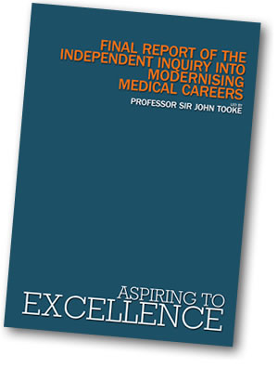

Slide 12
So what is excellence…?

Slide 13


What it’s not…!

Slide 14
A learning trajectory for professionals
Excellence
Proficiency
Competence
Mastery
Advanced beginner
Novice (Incompetence)
Experience
After Dreyfus and Dreyfus

Slide 15
Excellence is ‘competence plus…’

Slide 16
A learning trajectory for professionals
Education performance gap
Excellence
Service Performance gap
Proficiency
Competence
Mastery
Advanced beginner
Novice (Incompetence)
Experience
After Dreyfus and Dreyfus

Slide 17
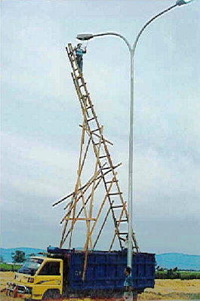
So what does a capable professional look like…?

Slide 18
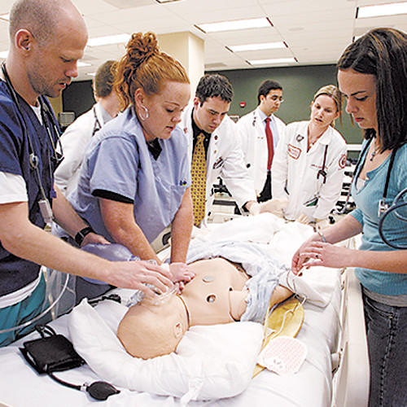
… a cog in a well-oiled machine…!

Slide 19
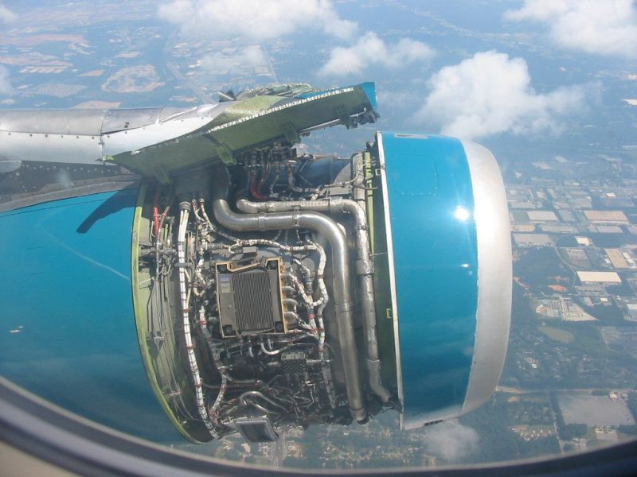
HELP!

Slide 20
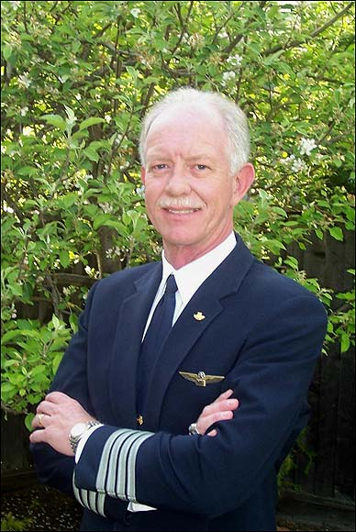
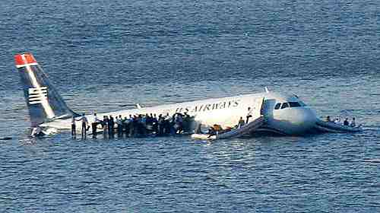
A professional…?
Cesley B Sullenberger III

Slide 21
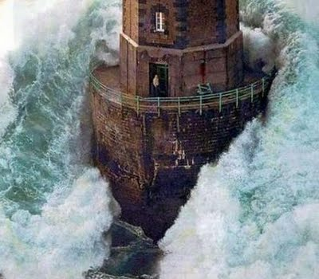
He or she who manages uncertainty, complexity or chaos!

Slide 22
How might you describe this professional excellence?

Slide 23

Professional excellence…
Right person or team
Right thing
Right way
Right time…
…in the circumstances

Slide 24
Domains of Professional Practice
Professional Behaviour
Professional
capabilities
Technical skills
Knowledge

Slide 25
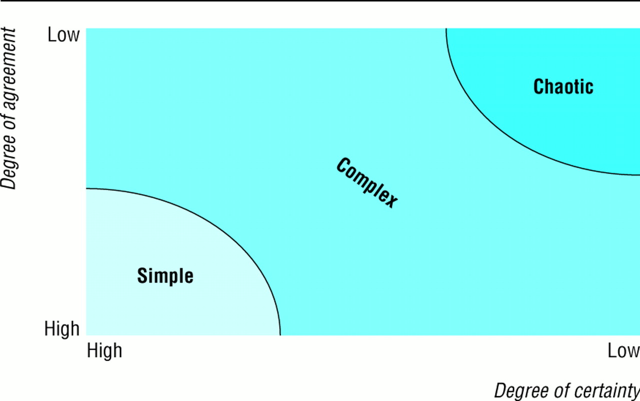
Complexity and chaos

Slide 26
Developing capabilities far beyond competence
Context unfamiliar
‘Education’
Capabilities
Uncertainty
Task familiar
Task unfamiliar
Certainty
Competences
‘Training’
Context familiar

Slide 27
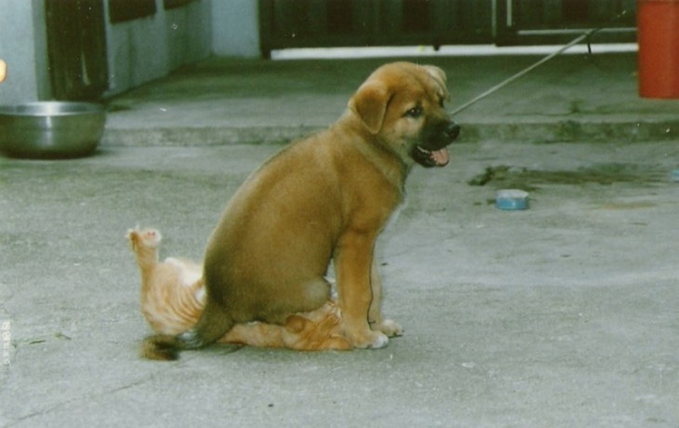
Few battle-plans survive first contact with the enemy…

Slide 28
How might you measure professional excellence or capability?

Slide 29
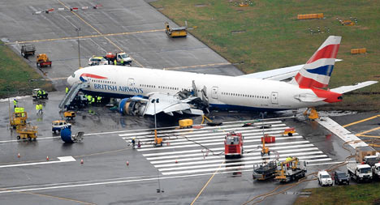

Slide 30
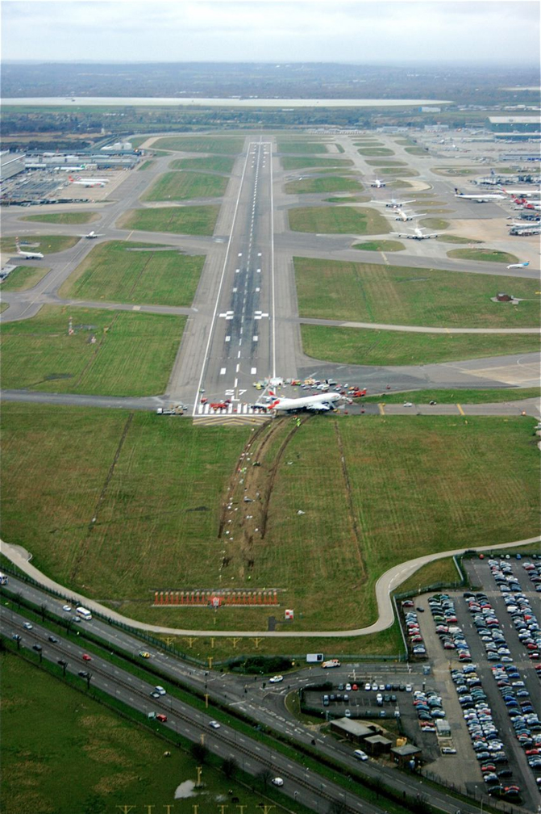

Slide 31


Slide 32
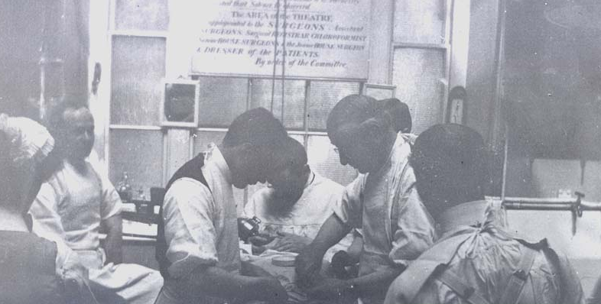
In the ‘Good Ole Days’!
See one!
Do one!
Teach one!

Slide 33
May be not such Good Ole Days?
Towards
Clinical excellence
Excellent
Patient safety
Proficient
Competent
Mastery
Patient risk
Advanced beginner
Novice (Incompetent)
Experience
After Dreyfus and Dreyfus

Slide 34

Risk

Slide 35
HAZARDOUS
REGULATED
ULTRA-SAFE
(>1/1000)
(<1/100K)
100,000
Health Care
Driving
10,000
1,000
Scheduled
Total lives lost per year
Airlines
100
Chemical
European
Mountain
Manufacturing
Railroads
10
Climbing
Bungee
Chartered
Nuclear
Jumping
Flights
Power
1
1
10
100
1,000
10,000
100,000
1million
10million
Number of encounters for each fatality
Patient Safety First Campaign
Notes:
35
Key message
Some overall context about the relative hazards of healthcare
Suggested script
This is a slide which you may have seen before. It’s worth noting as a reminder of the fact that healthcare is more hazardous than a number of other activities with the image of being ‘dangerous’.

Slide 36

To Err Is Human
Building a Safer Health System
Linda Kohn, Janet Corrigan, and Molla Donaldson, Editors
Committee on Quality of Health Care in America
INSTITUTE OF MEDICINE
NATIONAL ACADEMY of SCIENCE PRESS
Washington, D.C. ©2000
1999: IOM report lit the simulation education fuse
Kohn LT, Corrigan JM, Donaldson MS. To err is human: building a safer health system. Washington, DC, National Academy Press; 1999
Notes:
36
Incidents involving medical errors have been reported in the media in the past few years.
Due to increased publicity and concern, the Institute of Medicine’s (IOM) Committee on Healthcare in America published the famous report “To err is human: Building a Safer Health System”
Highlighted preventable medical errors in the US As many as 98,000 Americans die in hospitals each year as a result of medical errors (1999 IOM report)
Exceeds deaths due to MVA (43,458), breast cancer (42,297), AIDS (16.516).
Published measures to prevent them
Suggested use of simulation education- explosion in interest and scientific inquiry
Current estimates suggests that this number is a significant UNDER-estimate. Current estimates are that about 250,000 Americans die each year as a result of medical error.

Slide 37
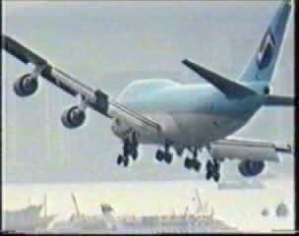

Slide 38
National Patient Safety Agency
4 million data sets…
That’s 4 million separate patient incidents!
Since 2005…

Slide 39
Data…
Information…
Knowledge…
Wisdom…

Slide 40
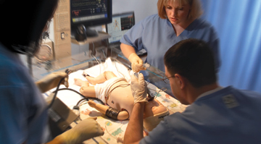
Zero tolerance of ‘never events’

Slide 42
Domains of Professional Practice
Risk behaviour ?
Professional Behaviour
Generic skills?
Professional
capabilities
Excellent
Technical skills
Knowledge

Slide 43
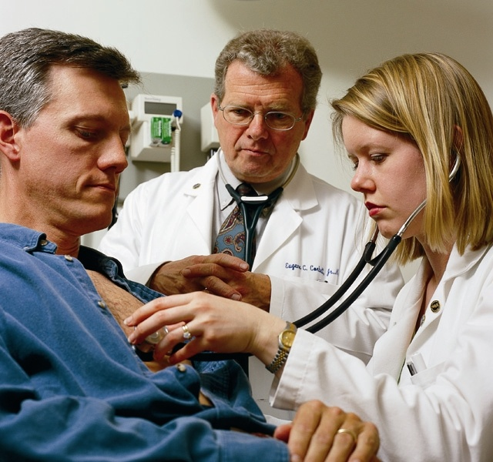
Generic Professional Capabilities?
Assertive communication
Effective team working
Task management
Decision making
Situational awareness

Slide 44
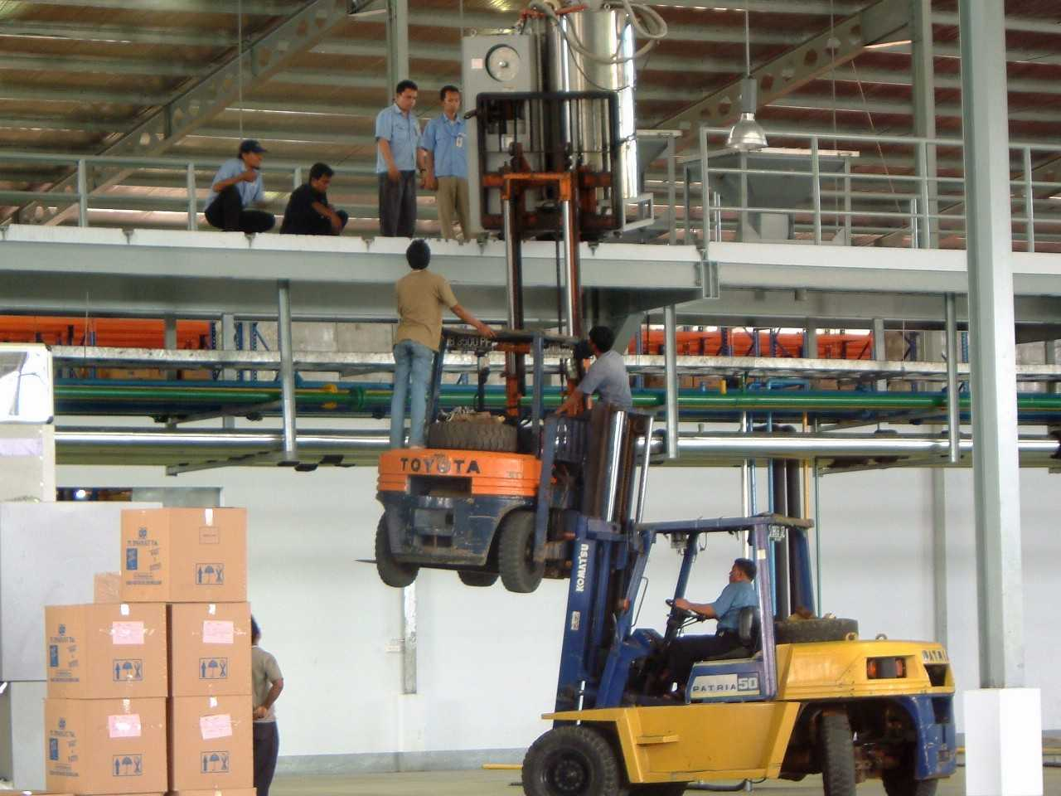
Effective team?
Good risk management?

Slide 45
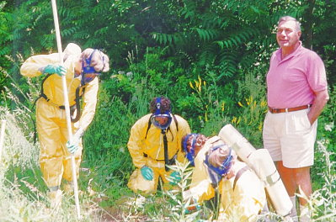
Situational Awareness?

Slide 46
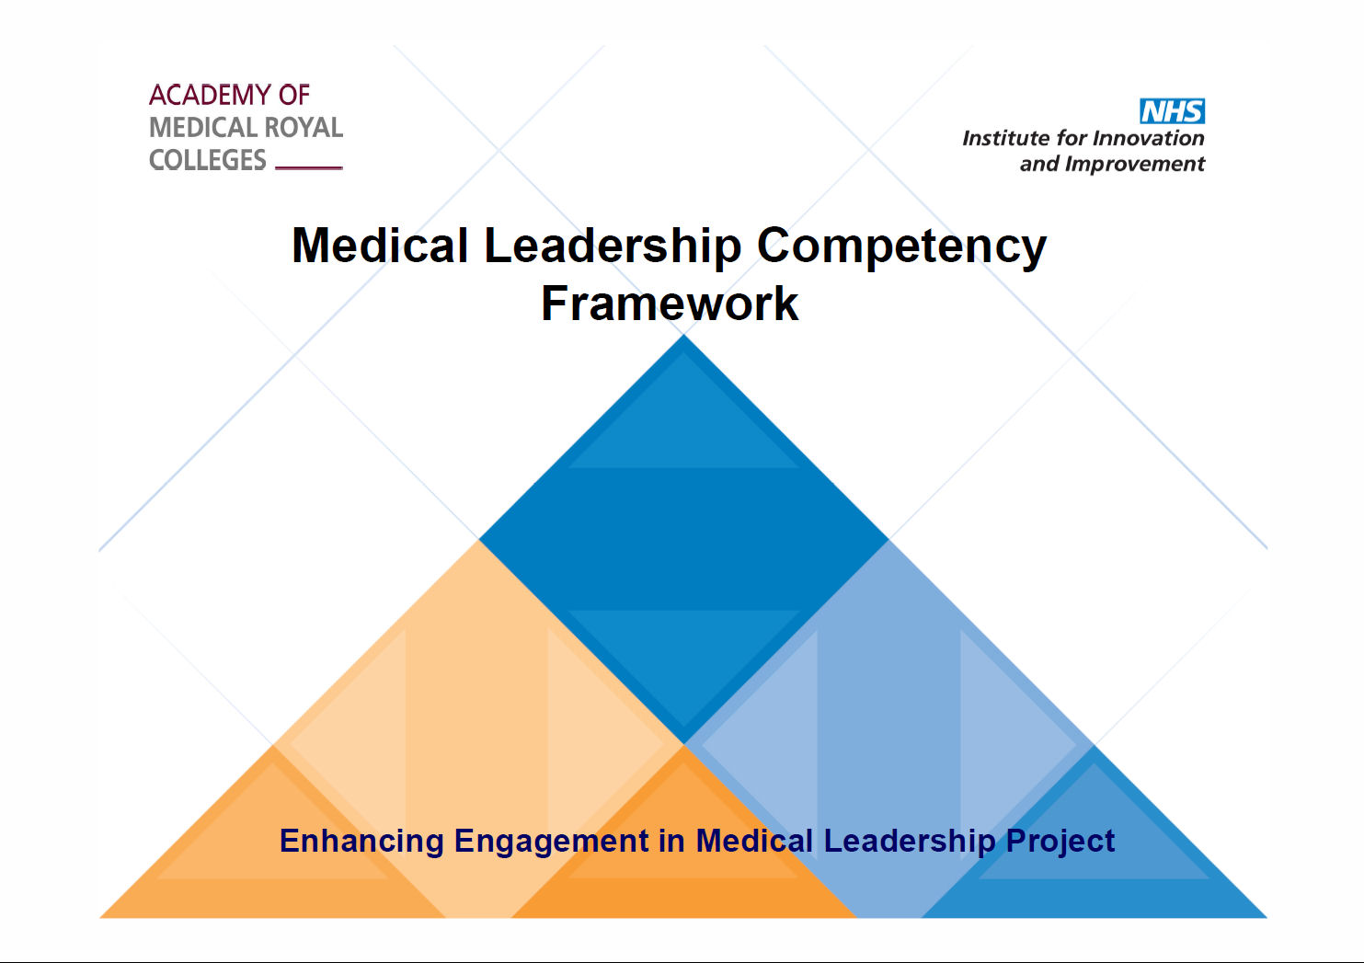
And Followership
Notes:
46

Slide 47
Domains of Professional Practice
Professional Behaviour
EQ/VQ
SQ
PQ
IQ
Professional
capabilities
Technical skills
Knowledge

Slide 48

Professional and Corporate continence!

Slide 49
Domains of Professional Practice
Beliefs and values
Professional Behaviour
Professional
capabilities
Technical skills
Knowledge

Slide 50


Slide 51
Dee Hock on professional qualities
Promote first on the basis of integrity;
second, motivation;
third, capacity;
fourth, understanding;
fifth, knowledge; and
last and least, experience.

Slide 52
Because…
Without integrity, motivation is dangerous;
without motivation, capacity is impotent;
without capacity, understanding is limited;
without understanding, knowledge is meaningless;
without knowledge, experience is blind.

Slide 53
Do not underestimate the importance of beliefs and values and their impact upon performance
Beliefs beget behaviours
Consider how you are developing yours?

Slide 54

So how do we cultivate such valuable beasts?

Slide 55
The Art of creating Learning…
+
Potential
Learning opportunities
Strategic issues
Operational issues
=
Curricula
Standard setters
Regulators
Owners
Providers
Funders
Commissioners
Faculty
Facilities
Programme development
Educational leadership
Educational philosophy
Organisational culture
Assessment + metrics
Quality assurance
Personal traits
and preferences of….

Slide 56
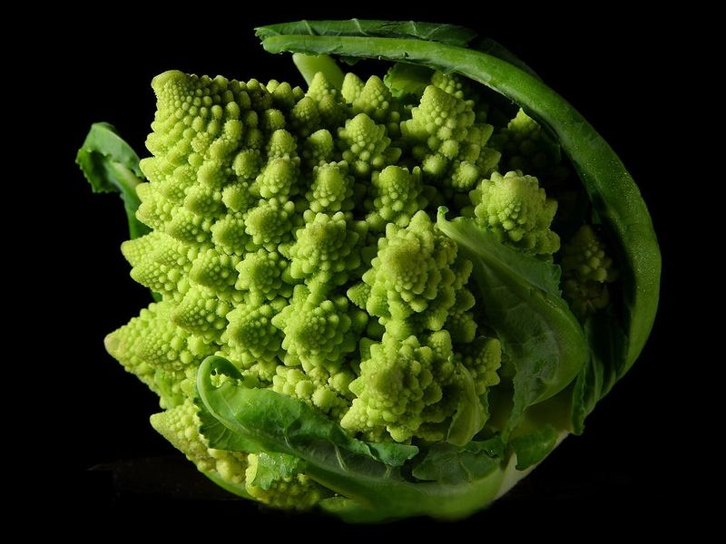
Quality issues… the fractals of learning
The System
The Organisation
The Team/Dept
The Individual

Slide 57
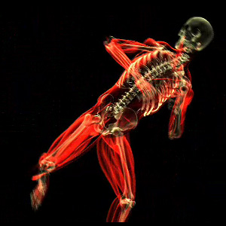
Innovations in education
Improve curriculum implementation
Improve quality of faculty
Improve quality of programmes
Better quality metrics
Improved feedback
More adaptive/bespoke elements
Aspiring to excellence

Slide 58

But first a caution!

Slide 59
Beware the Icemen!...

Slide 60


Slide 61
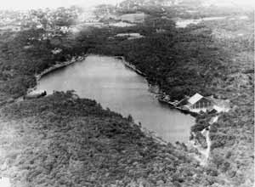
The ice man cometh…

Slide 62
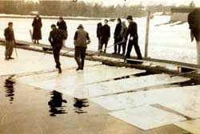

Slide 63
The ice man cometh…

Slide 64
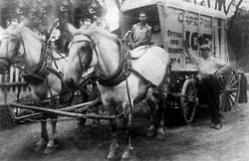
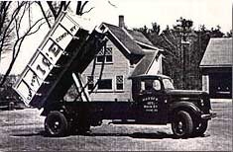

Slide 65
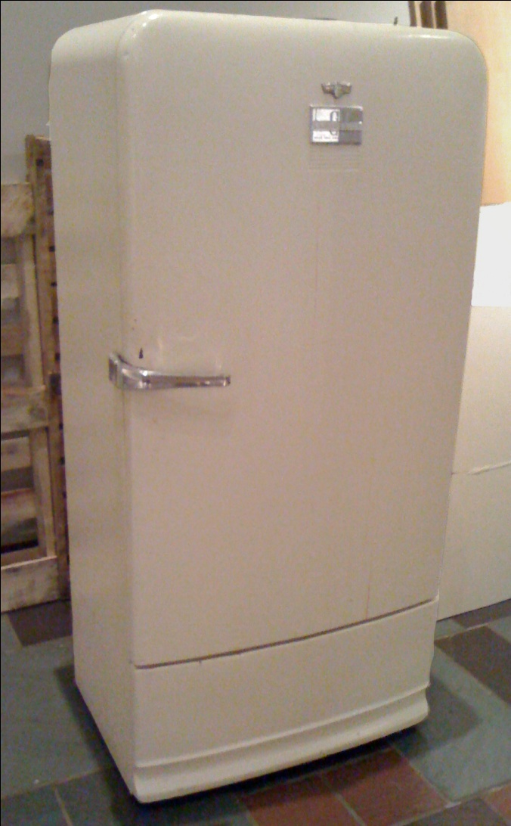
Kelvinator, Frigidaire, Electrolux…

Slide 66
…the moral of this chilly tale?
Never mistake the ACTIVITY for the VALUE proposition

Slide 67
Education Commissioning Strategy
Specialty
Service
Educational Capacity and capability

Slide 68
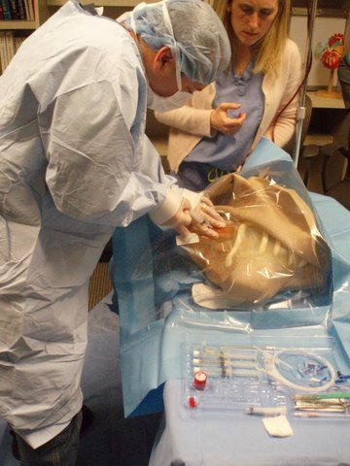
Doing the right thing, first time…!
‘Just in time training’
‘Training to excellence’
Grounded in the needs of the service
Graded supervisedexposure
Safer learning opportunities
Cost effective

Slide 69

Academy of Medical Educators
Better educators…

Slide 70

Better induction, supervision, selection…

Slide 71
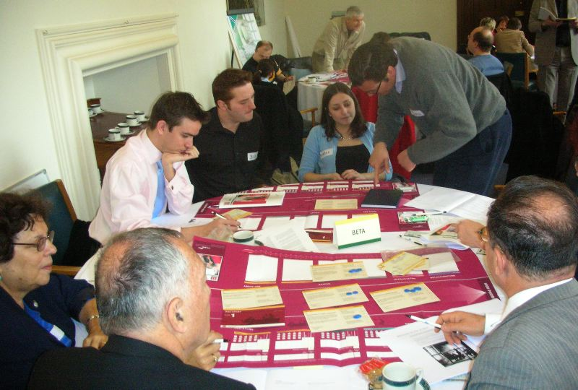
Better Educational Leadership & Management of training

Slide 72
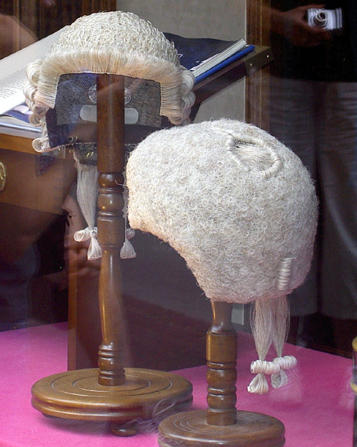
Better assessment and meaningful metrics

Slide 73
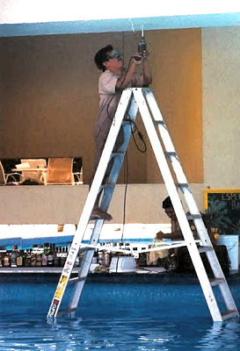
Better remediation of poor performance…

Slide 74
Simulation has been used for years in other high performance industries
More innovative educational solutions…

Slide 75
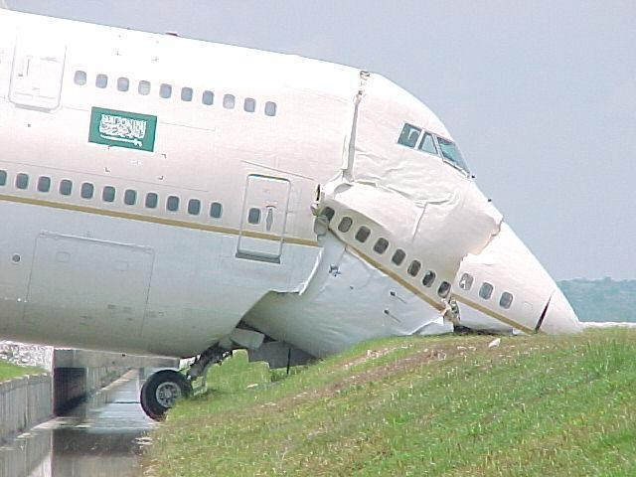
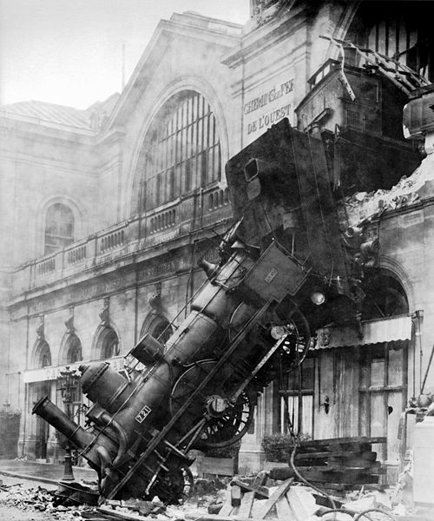
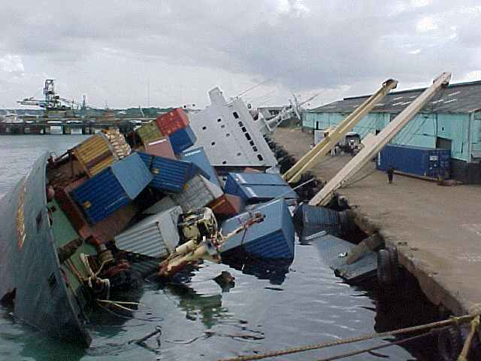
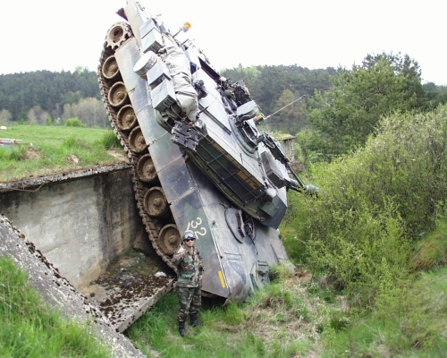

Slide 76

The Egg and Bacon Principle!

Slide 77
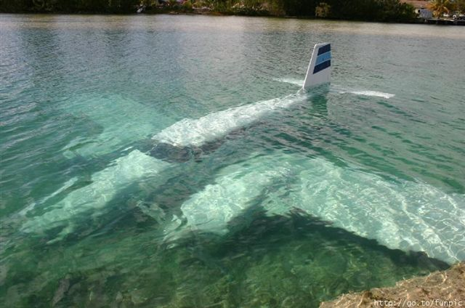
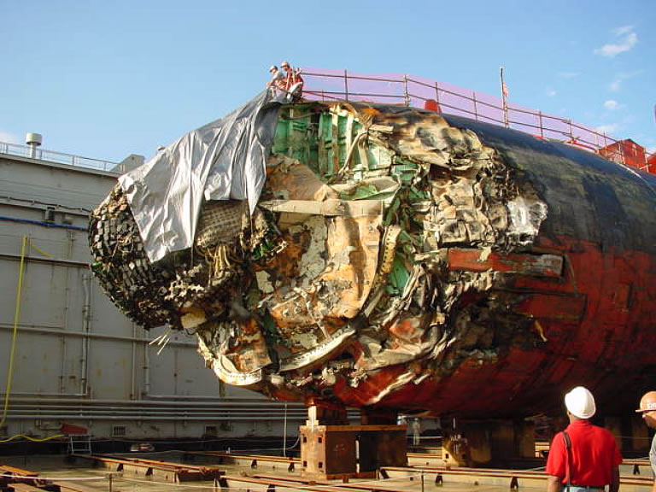
Unacceptable cost of performance failure
Unacceptable cost of training failure

Slide 78
Why all the interest in healthcare simulation now?

Slide 79
CMO’s Report - Sir Liam Donaldson
Safer Medical Practice – machines, manikins and polo mints
March 2009

Slide 80
CMO’s report Safer Medical Practice - recommendations March 2009
Simulation-based training should be fully integrated and funded within training programmes for clinicians at all stages.
Simulation-based training needs to be valued and adequately resourced by NHS organisations.
A skilled faculty of expert clinical facilitators should be developed to deliver high-quality simulation training.
The importance of human factors training to safe care should be widely communicated.

Slide 81
NHS England Report
Simulation – Current provision and use
Task training
Inter-professional multi-disciplinary training
Training in patient safety and human factors
NPSA guidelines, SUIs and critical incidences
Building organisational resilience
Towards excellence… a national strategy

Slide 82

London’s response

Slide 83
21st Century solutions…?
Simulation &
Technology-
enhanced
Learning
Initiative

Slide 84
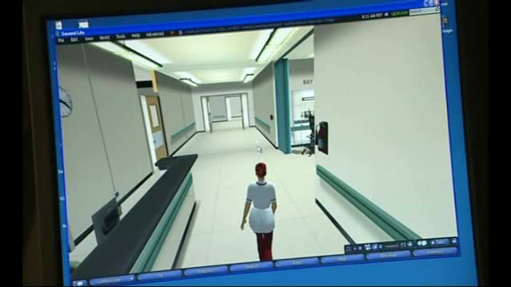

Slide 85
Innovations - Skills ‘Boot camps’
Focused/Accelerated learning
Experiential learning
Improved Patient safety!
Mastery
Improved productivity!
Time

Slide 86
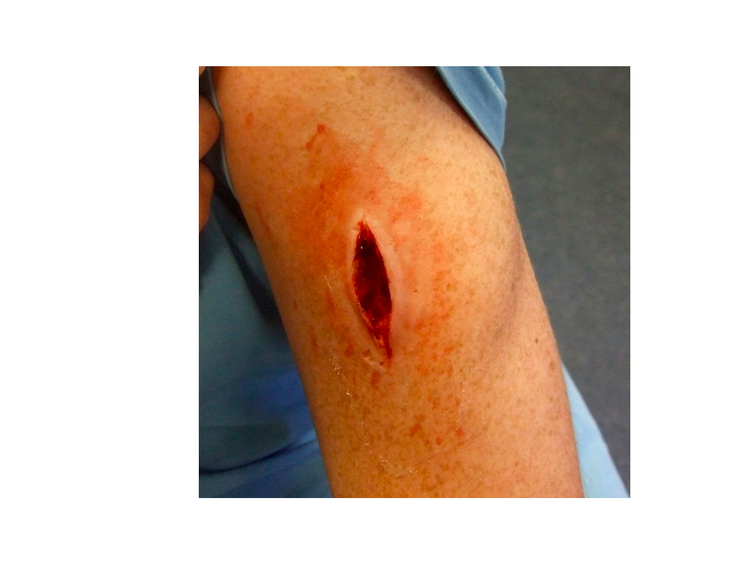
Prosthetic wounds

Slide 87
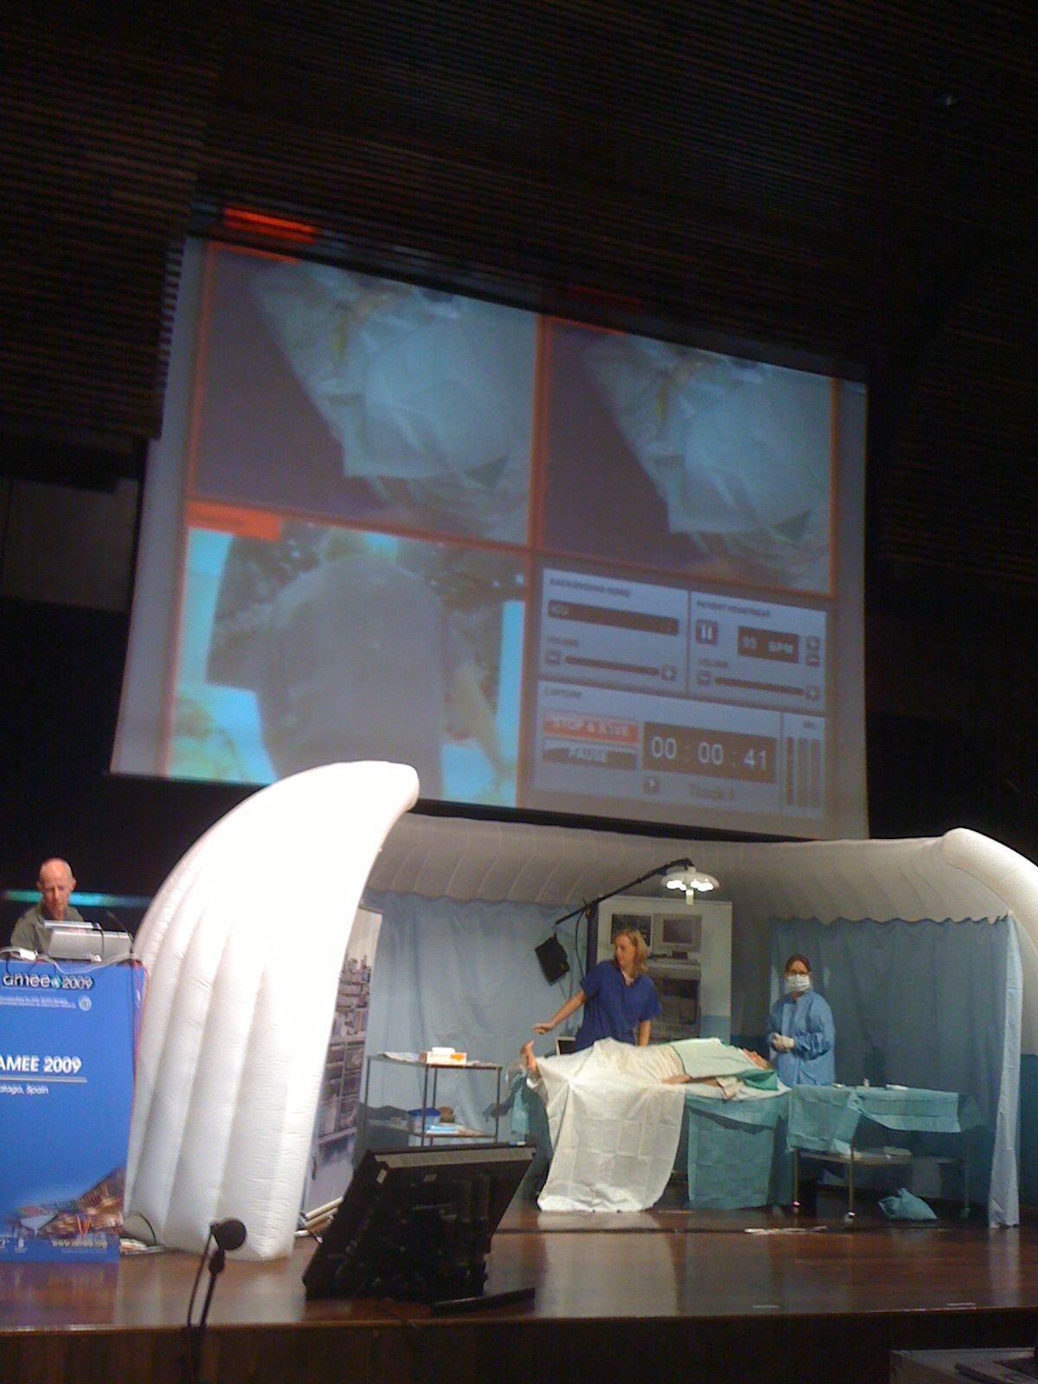
21st Century Solutions?
STeLI R+D successes
Distributed Simulation
Contextualised Simulation
Hybrid Simulation

Slide 88
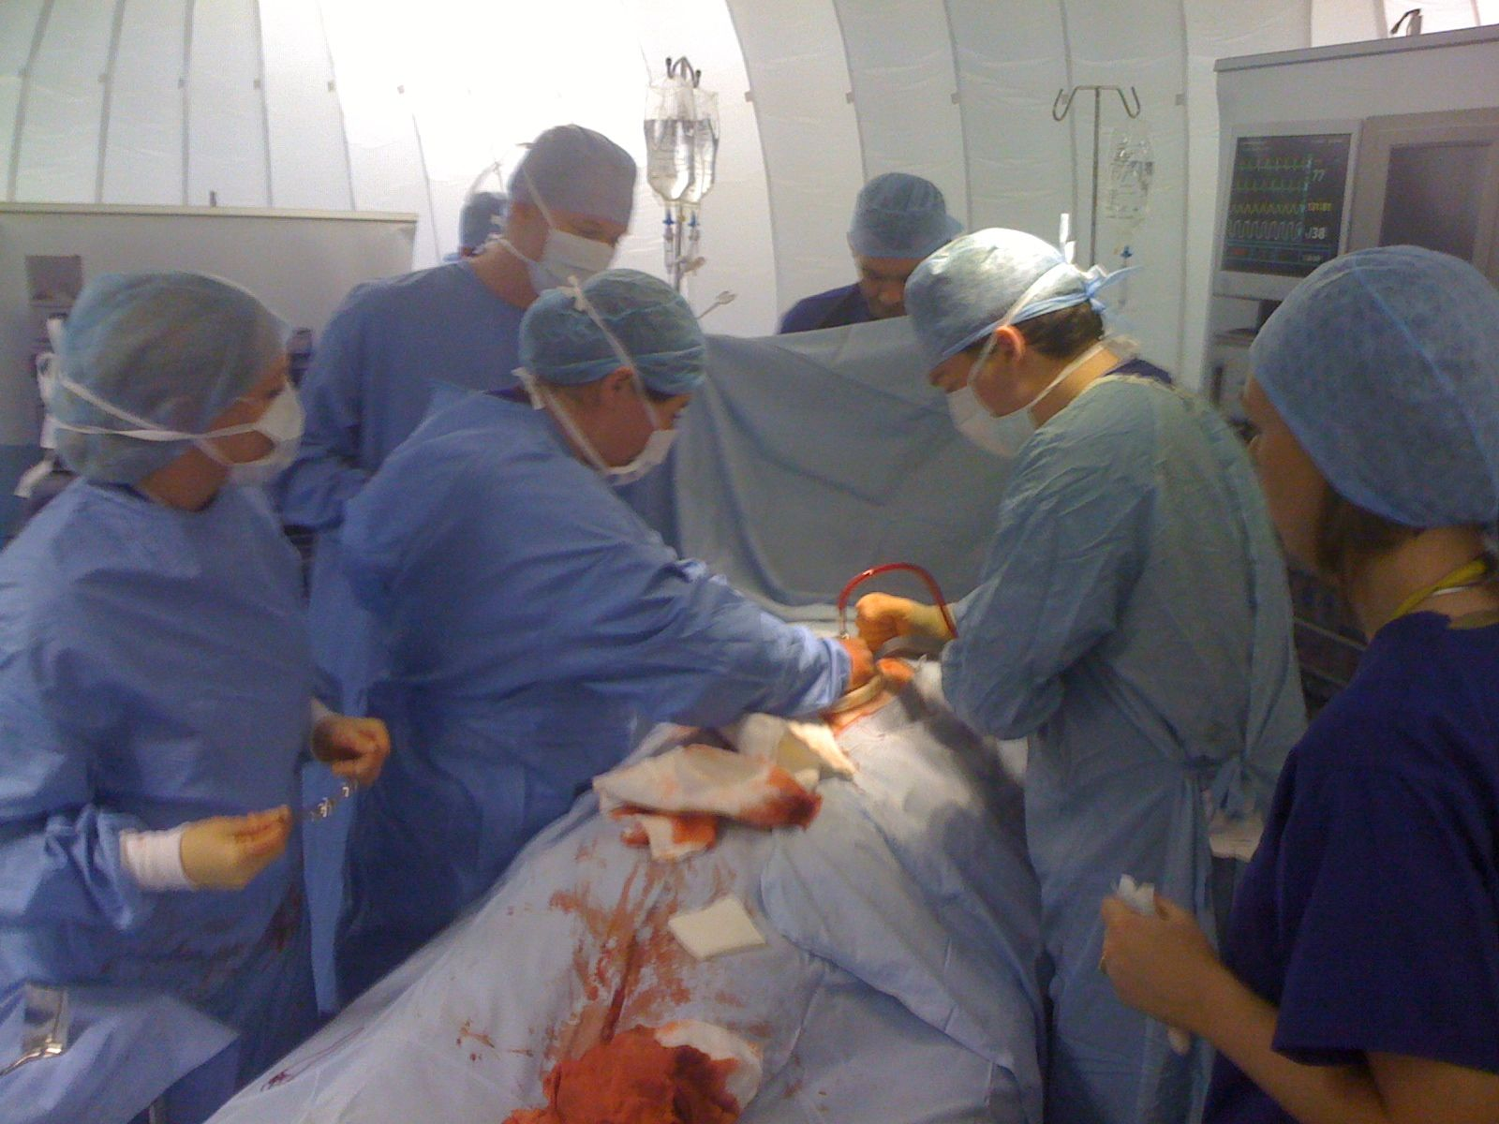
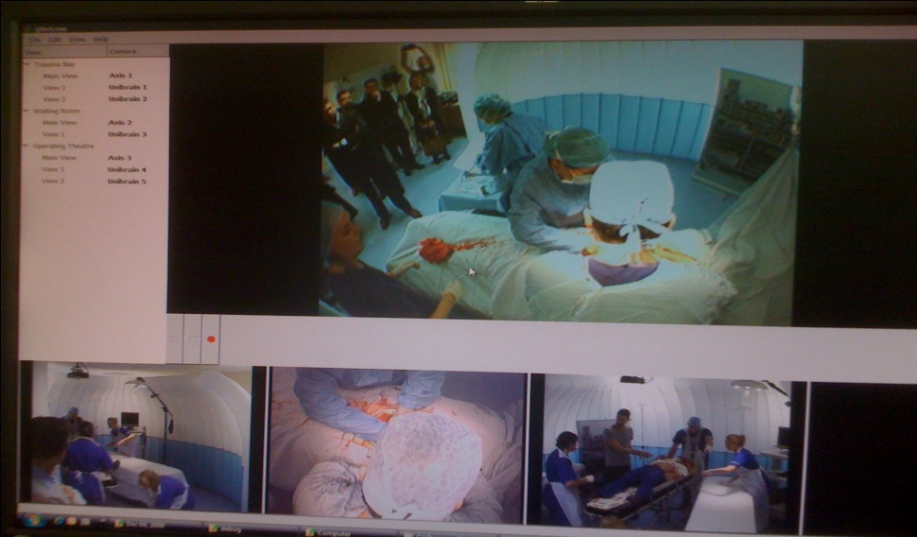
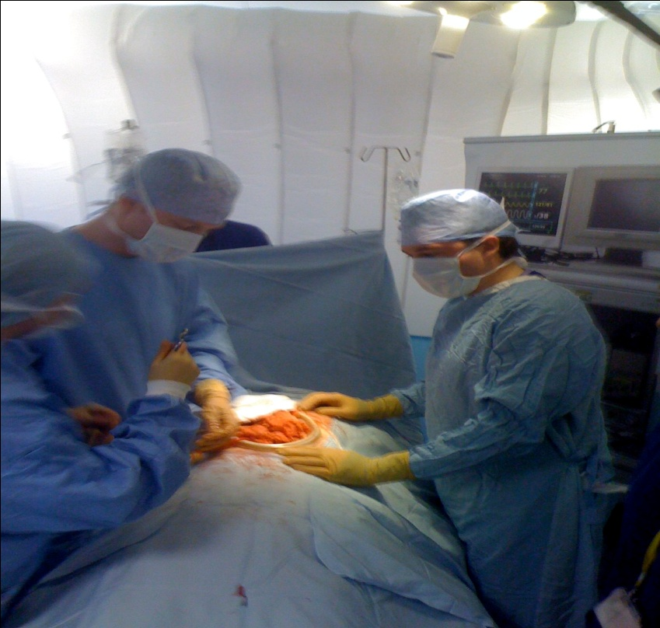
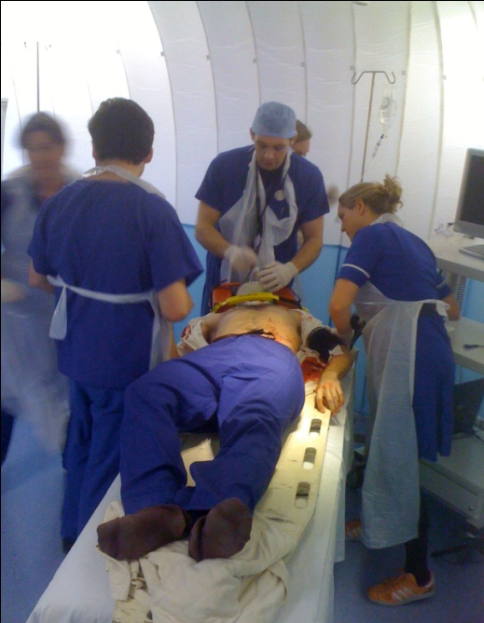

Slide 89
A simulation enhanced learning trajectory
Minimised and
managed risk
to patients
Excellent
Supervised clinical practice
In situ simulation
Proficient
Safety threshold
Competent
Mastery
Distributed Simulation
Advanced beginner
Task Simulation
Novice (Incompetent)
Experience
Curran after Dreyfus and Dreyfus

Slide 90
21st Century solutions…?
Simulation &
Technology-
enhanced
Learning
Initiative

Slide 91
Technology-enhanced Learning…

Slide 92
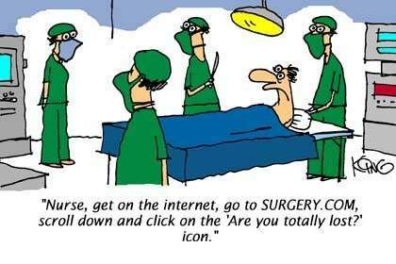

Slide 93


The challenges…
Training the iGeneration!

Slide 94
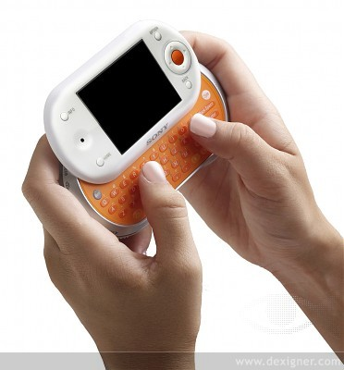
Digital natives…

Slide 95


Slide 96
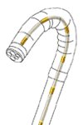
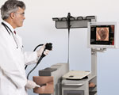
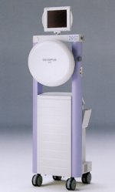

Technology enhanced clinical learning

Slide 98
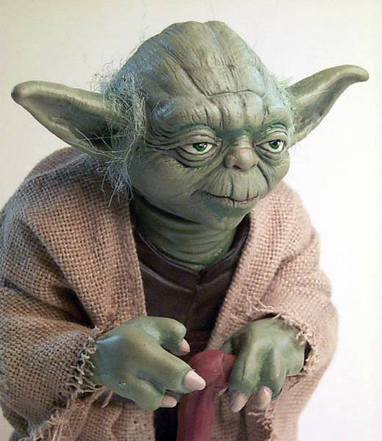

Slide 99
The importance of Faculty…
Vital ingredients for educational success
Set the learning environment
Own curriculum
Act as advocates
Act as repository of expertise
Act as founts of wisdom…

Slide 100




Stages of development
Unconscious incompetence
Conscious incompetence
Conscious competence
Unconscious competence

Slide 101

Higher level insight
Clinical Wisdom!

Slide 102


Slide 103

The importance of effective feedback

Slide 104

Feedback is a gift!

Slide 105

Johari’s Window
Things I know
Things I don’t know
Things you know
Things you don’t know
?

Slide 106
Beware the intent behind a remark!

Slide 107

The importance of effective communication…

Slide 108


Slide 109
I’m ok, you’re not ok!

Slide 110


Slide 111
I’m ok, you’re not ok, but I’m not going to tell you!

Slide 112


Slide 113
I’m not ok…

Slide 115
I’m ok, you’re ok!

Slide 116
Academy of Medical Educators
Professional Standards
Themes:
- Core Values of Educational Professionals
- Educational Scholarship
- Design and planning of learning activities
- Teaching and supporting learners
- Assessment and feedback to learners
- Educational management and leadership
Notes:
116

Slide 117


Professional Standards
Academy of Medical Educators 2009
Notes:
117

Slide 118
In summary
Better training…
Every hour packing its educational punch - (Temple 2010)
Safe for all concerned – (Collins 2010 and Donaldson 2009)
Aspiring to excellence – (Tooke 2008)
Effective, efficient and adaptive

Slide 119

Don’t forget it’s a jungle out there..

Slide 120
Domains of Professional Practice
Beliefs and values
Professional Behaviour
Generic skills
Professional
capabilities
Technical skills
Knowledge

Slide 121
A learning trajectory for professionals
Excellence
Proficiency
Competence
Mastery
Advanced beginner
Novice (Incompetence)
Experience
After Dreyfus and Dreyfus

Slide 122
A simulation enhanced learning trajectory
Minimised and
managed risk
to patients
Excellent
Supervised clinical practice
In situ simulation
Proficient
Safety threshold
Competent
Mastery
Distributed Simulation
Advanced beginner
Task Simulation
Novice (Incompetent)
Experience
Curran after Dreyfus and Dreyfus

Slide 123
Don’t forget the icemen!

Slide 124

‘If you think education is expensive try ignorance’
Derek Bok, President of Harvard

Slide 125




World Class Workforce
for
World Class Healthcare

Slide 127
‘If you think education is expensive try ignorance’
Derek Bok, President of Harvard

