Slide 1
Department of clinical medicine

Slide 2
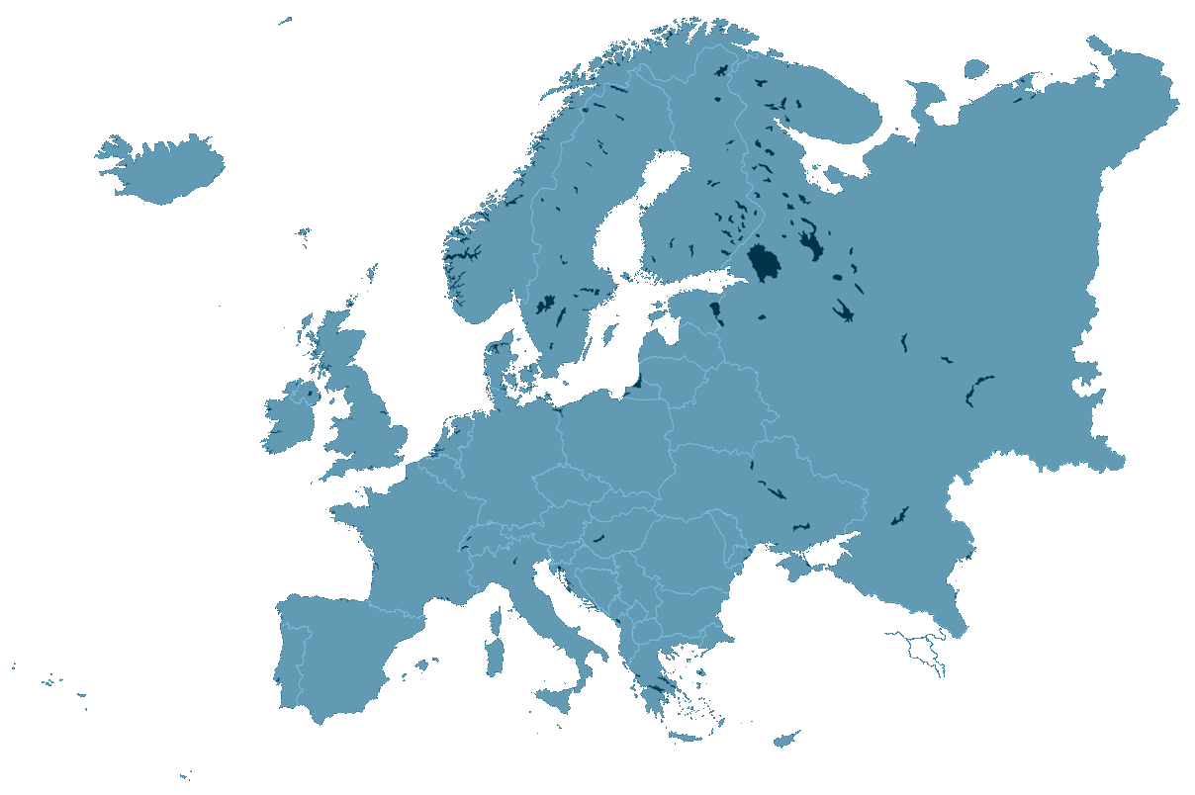

Slide 3
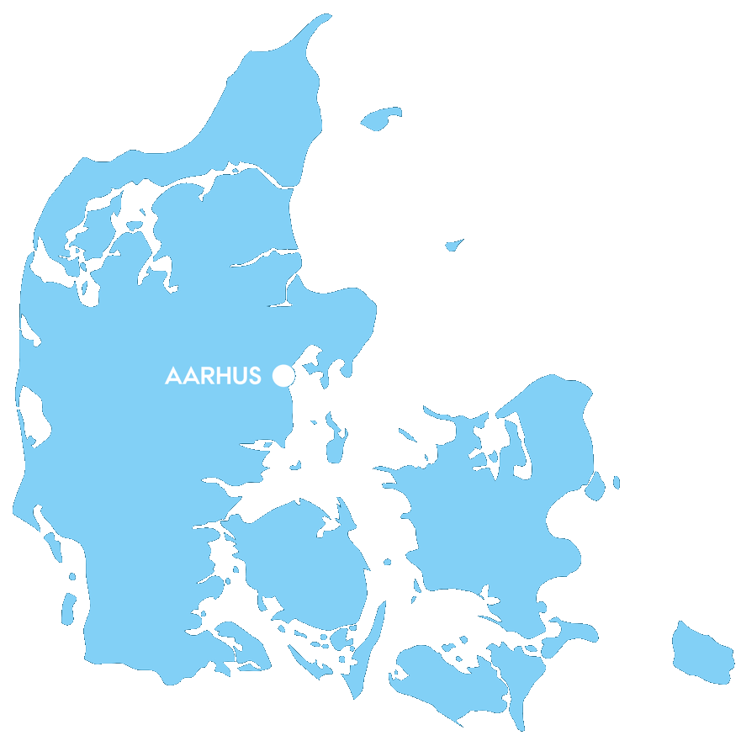

Slide 4
About aarhus university
Young modern university from 1928
Leading public research university covering the entire research spectrum
40,000 students, 3,000 international students
A graduate university: more than 50% of students study at Master’s or PhD level

Slide 5
Rankings aarhus university
RANKINGS 2017:
ARWU – Shanghai: 65
National Taiwan University Ranking: 88
Leiden Ranking: 101
Times Higher Education World University Ranking: 109
QS World University Ranking: 119

Slide 6
Faculties at aarhus university
Health
Science and Technology
Business and Social Sciences
Arts

Slide 7
About Faculty of health
5 DEPARTMENTS
1,360 EMPLOYEES
174 million euros IN REVENUE
Source: Profile Brochure 2017-2018

Slide 8
About Faculty of health
4,325 STUDENTS
310 INTERNATIONAL STUDENTS IN FULL DEGREE PROGRAMMES
Source: Profile Brochure 2017-2018

Slide 9
Mission – faculty of health
“The mission of Aarhus University, Health is to improve public health through research, talent development and education at a high international level, as well as to ensure knowledge dissemination and knowledge transfer throughout the field of healthcare”.

Slide 10
vision – faculty of health
Generate new and useful knowledge through top-class research
Support the development of those talents who are and will be employed at Health
Collect and communicate knowledge from and to the surrounding society
Nurture well-educated graduates who have completed relevant and expedient courses

Slide 11
Department of clinical medicine
A brickless organisation
Room for labs and research offices at several different hospital locations
Approx. 30,000 square meters of research facilities

Slide 12
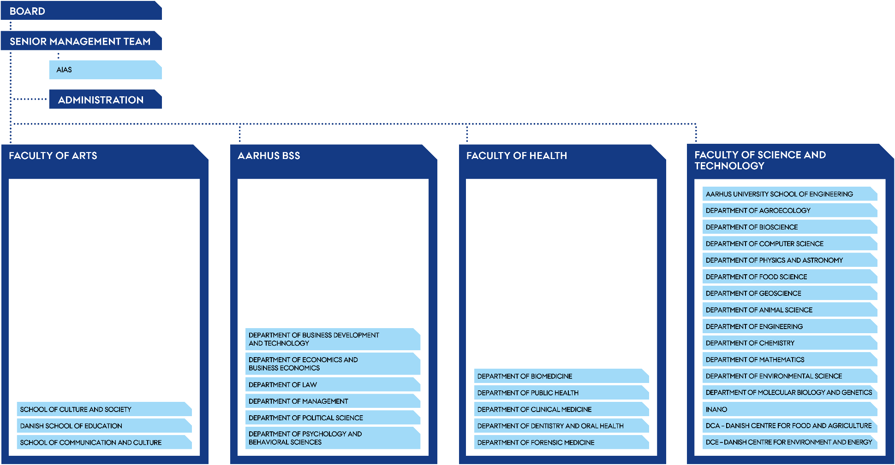
Department of Clinical Medicine

Slide 13
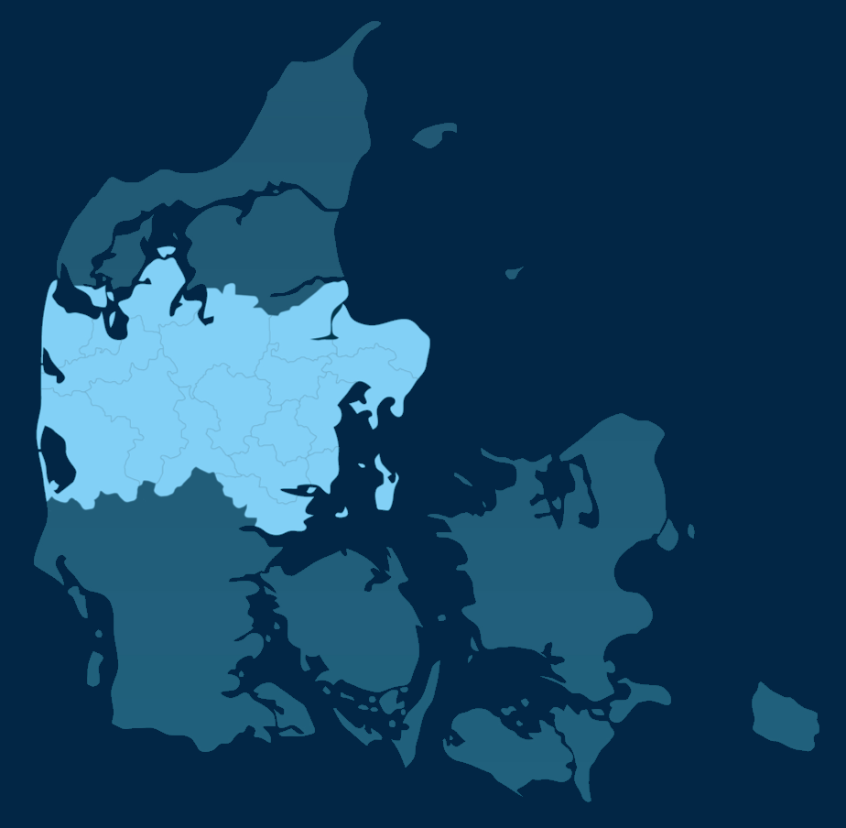
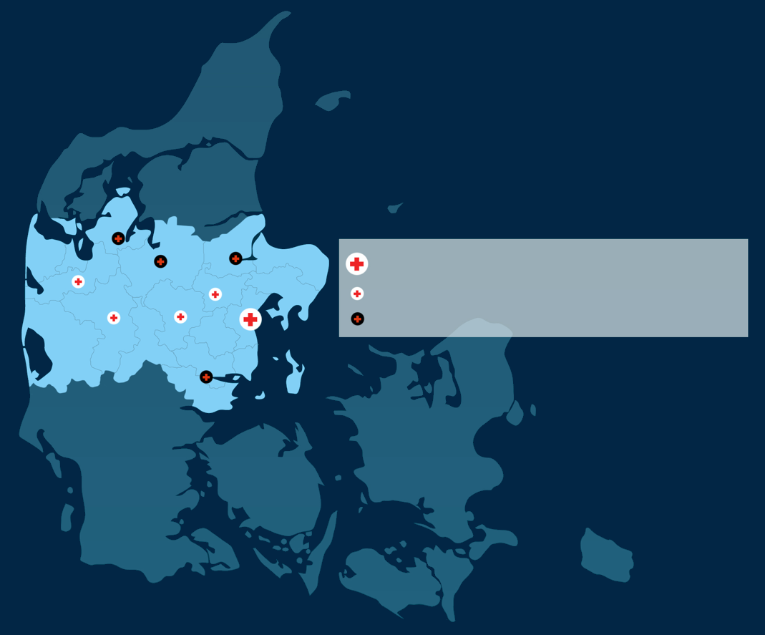
Aarhus University Hospital
Regional hospitals with university clinics
Other regional hospitals

Slide 14
History of dept. Of clinical medicine
1935: Experimental clinical research started
1952: Experimental surgical research started
1972: The Department was officially established as “Department of Experimental Clinical Research”
2011: Change of name: “Department of Clinical Medicine”

Slide 15
Academic staff – approx.
40 Professors (full time)
85 Clinical Professors (50% university, 50% clinical work)
65 Associate Professors (full time)
210 Clinical Associate Professors (part time university)
25 Assistant Professors
427 PhD students
Source: Health in numbers and HR Health HR (snapshot autumn 2018)

Slide 16
Research – basic and clinical
Most researchers work as both clinicians and researchers.
The Department of Clinical Medicine
conducts both basic health science research and clinical research
covers all medical specialities

Slide 17
Research – facts
Approx. 2,700 peer-reviewed publications in 2017
Overall turnover approx. DKK 357million (approx. 48 mio. euros) in 2017
External funding accounts for 45% in 2017

Slide 18
Research – facilities
Excellent and attractive research facilities, e.g.:
Advanced operating rooms for surgery on, e.g., pigs and mice
Good animal facilities for small and large animals
Advanced PET, PET-CT, MEG, CT and MRI scanners
Hyperpolarisation MRI spectroscopy
Many experimental laboratory facilities at Aarhus University and Aarhus University Hospital.

Slide 21
Education - students
Approx. 1,200 students (Master of Science in Medicine)
Approx. 70 medical students in research (“research year”)
Approx. 430 PhD students (2017)
IKM also has a commitment to the Master's degree in Molecular Medicine, Optometry and Visual Science, Biomedical Engineering and a number of other courses.
.

Slide 22
Education – structure (MA)
6 semesters
180 ECTS points

Slide 23
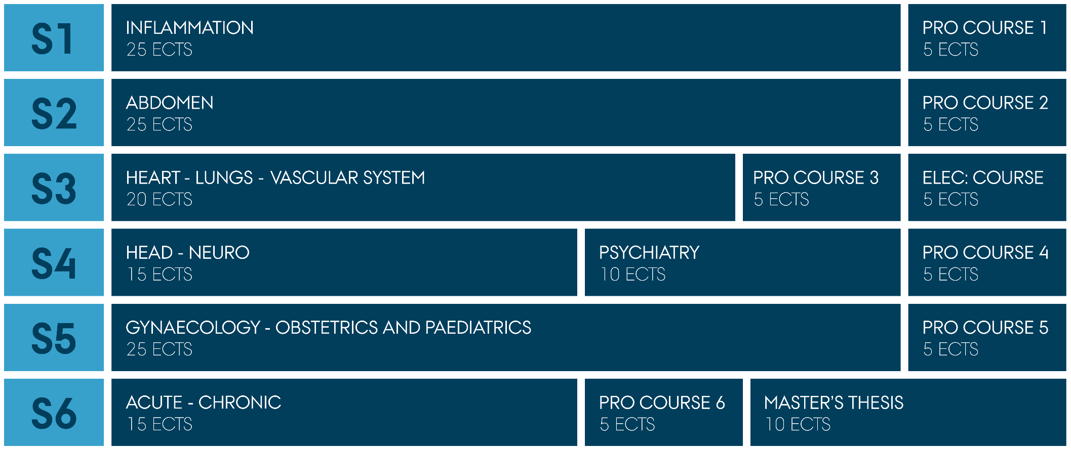
Education structure (MA)

Slide 24
collaboration – formal agreement
Integrated and mutually binding collaboration between the university and Aarhus University Hospital (AUH) at every relevant management level.

Slide 25
Collaboration formal agreement

Slide 26
collaboration – benefits
Integrated research and clinical activity
Research at the highest international level – from basic research to new treatments
Research and education at all hospitals and clinical departments
Attractive and stimulating working and educational environment

Slide 27
Industry collaboration
550 co-operation agreements annually
All clinical trials are approved by the department before the project is started
University and hospital have several support functions to assist researchers in setting up clinical trials and collaborating with the pharmaceutical industry

Slide 28
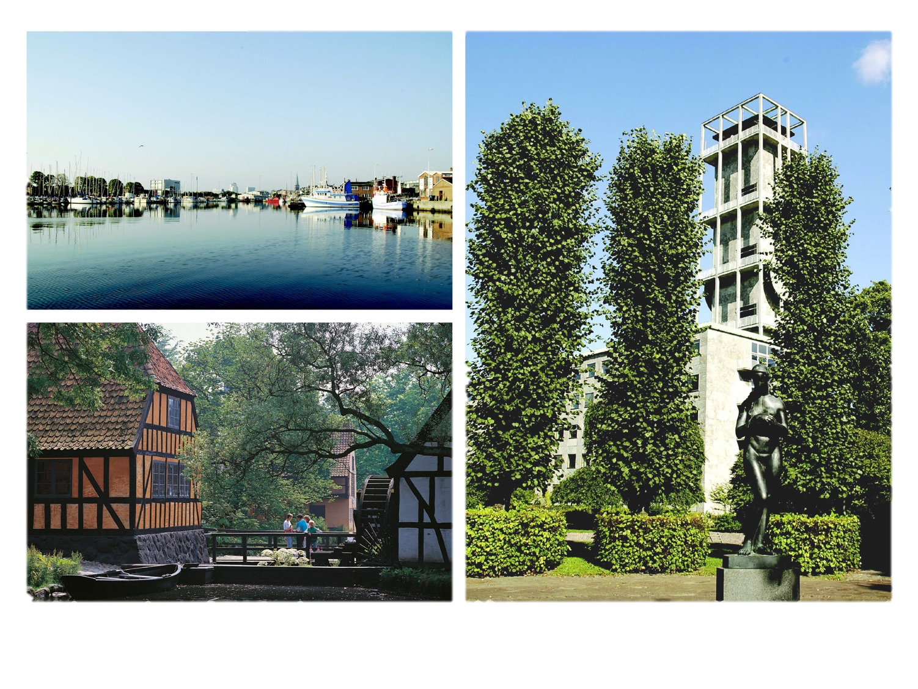

Slide 29
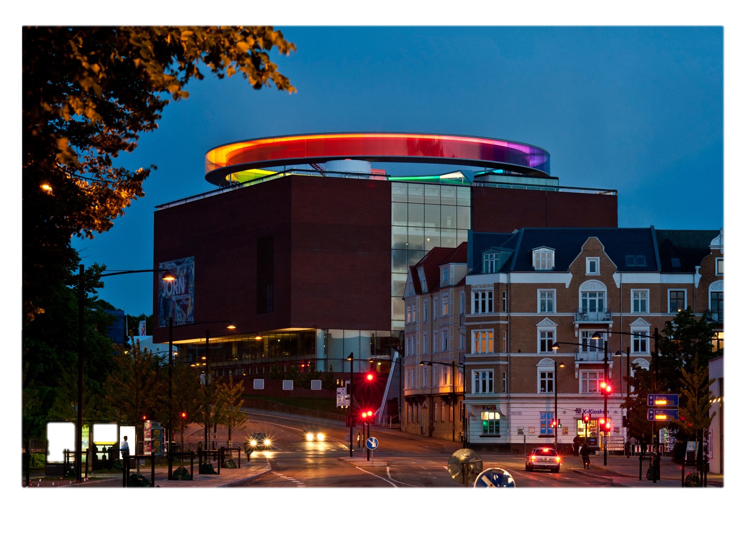

Slide 30
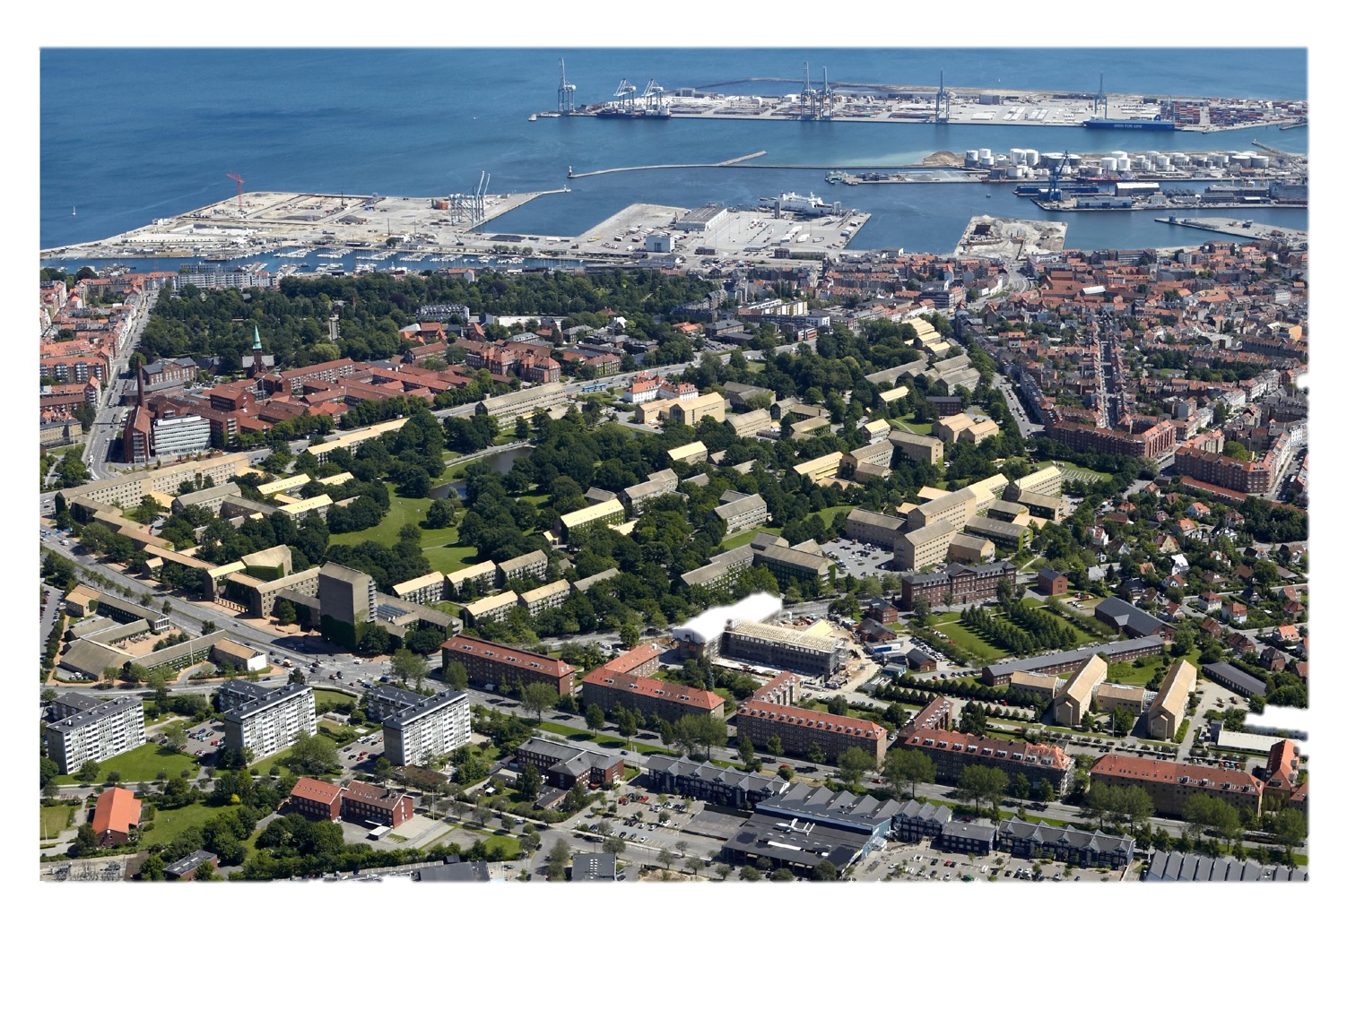

Slide 31
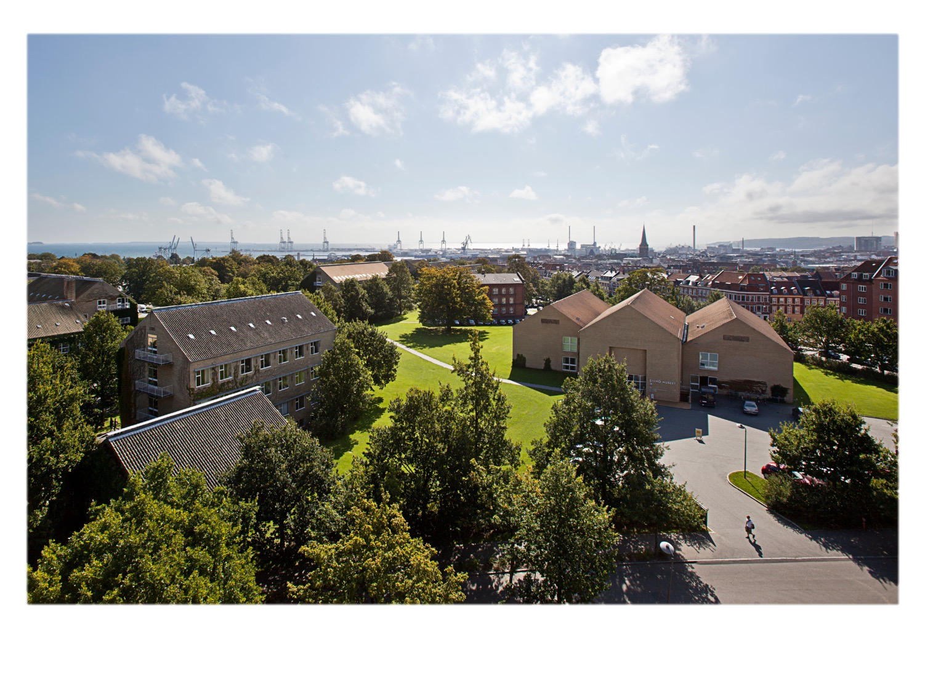

Slide 32
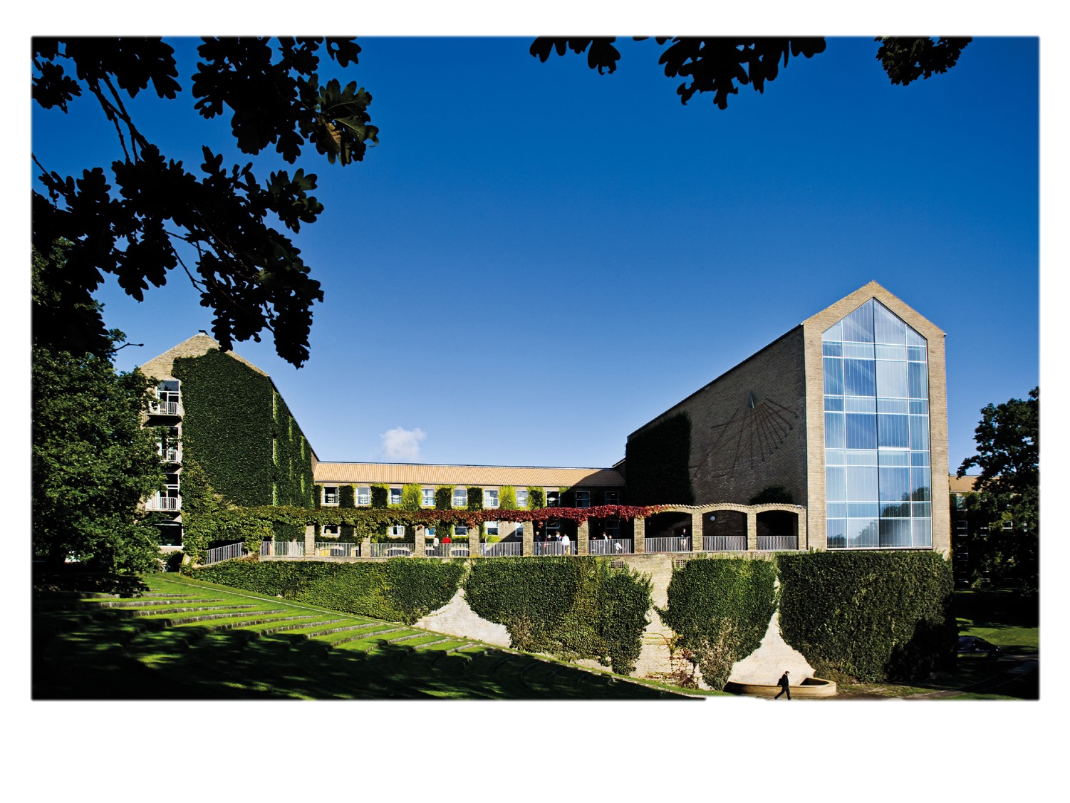

Slide 34
Insert Quote text, for next level ENTER and TAB
Insert Name

